Slide 1


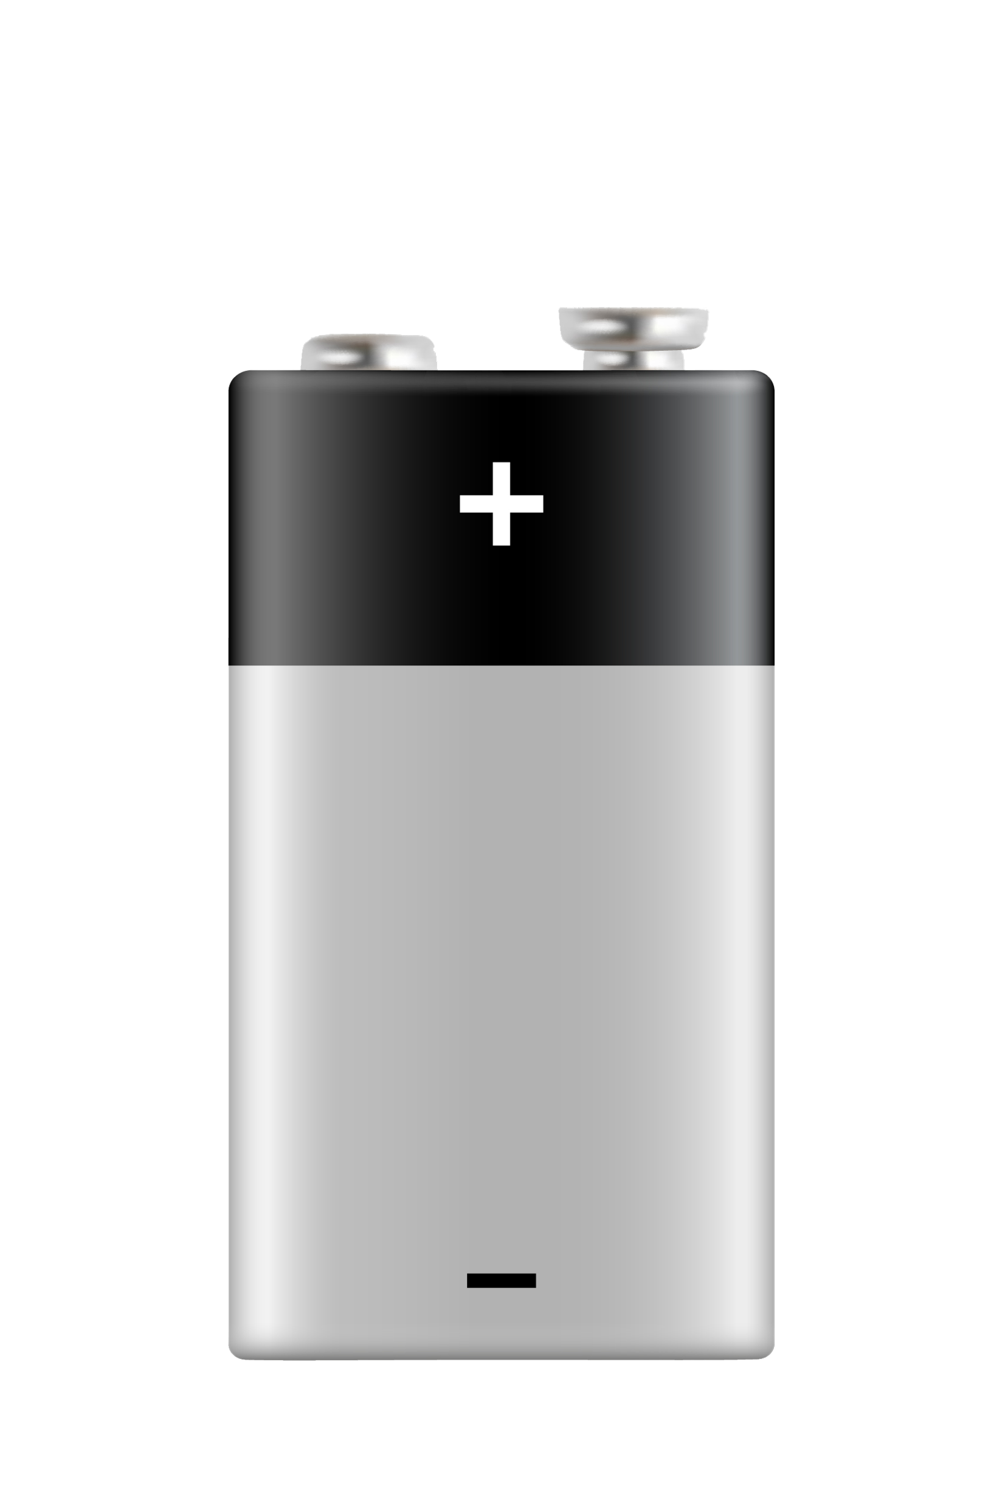
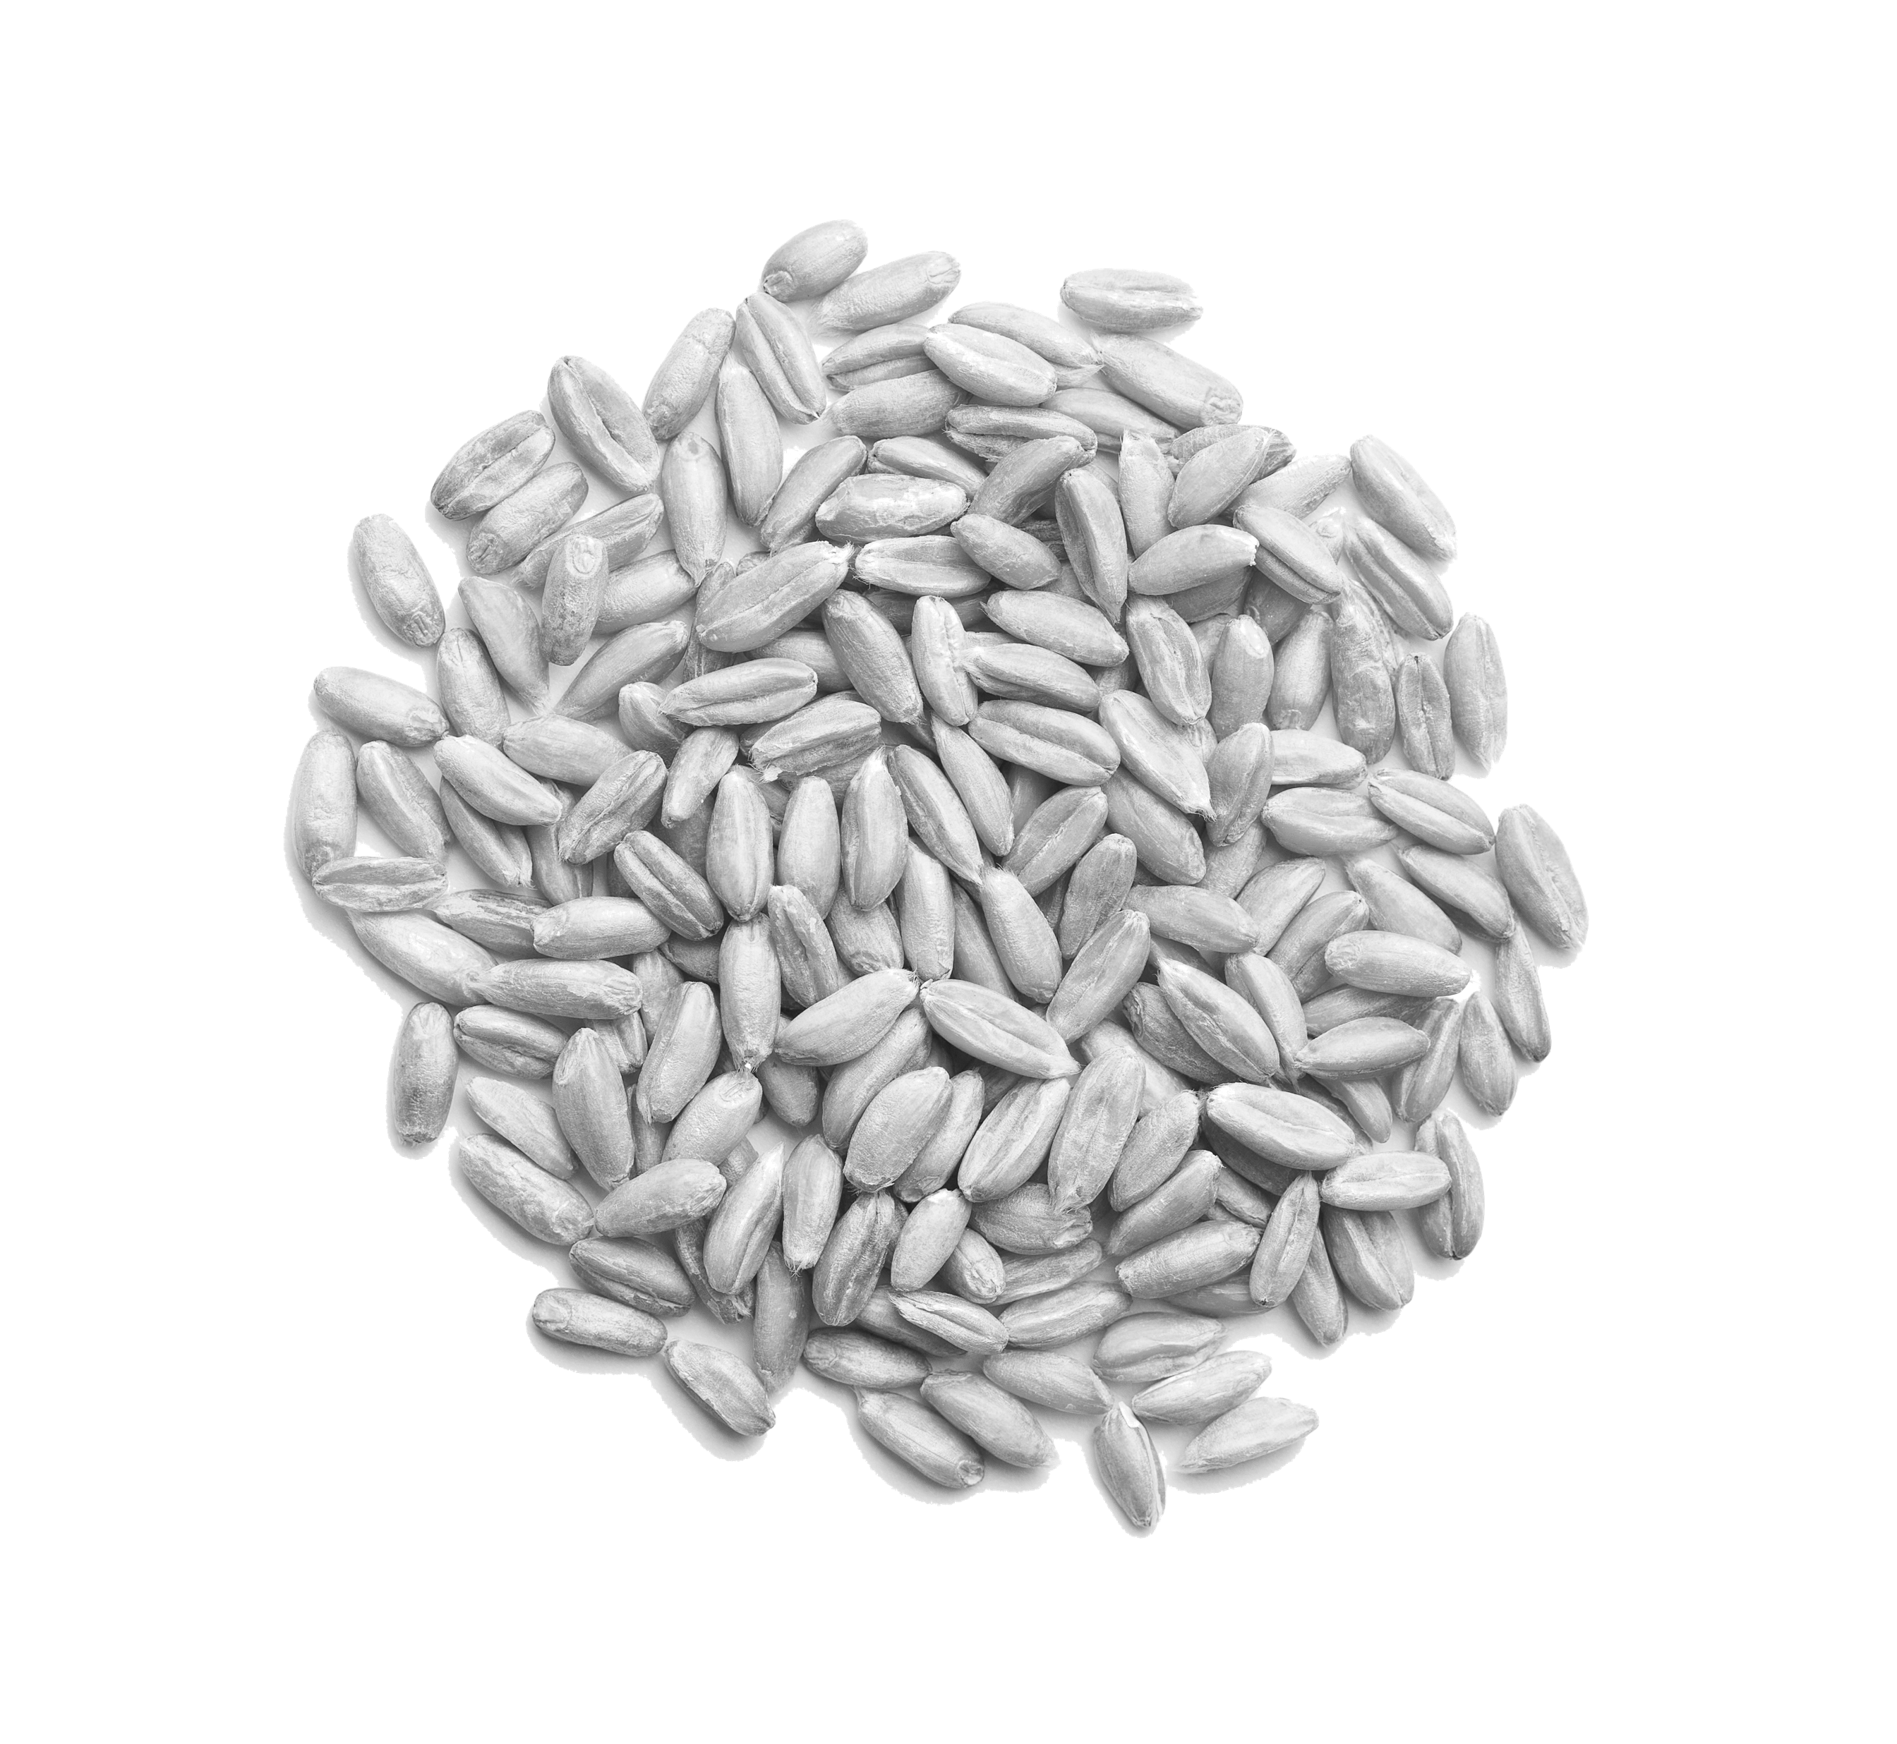
Fastmarkets Platform
Release Notes
November 2024

Slide 2
New Features
THIS RELEASE OF THE FASTMARKETS PLAFORM INCLUDES NEW FUNCTIONALITY AND FEATURES INCLUDING:
01
SAF Balance Sheets
02
Fastmarkets/USDA Barley Balance Sheet Comparison
03
Fastmarkets/USDA Soybean Balance Sheet Comparison
2

Slide 3
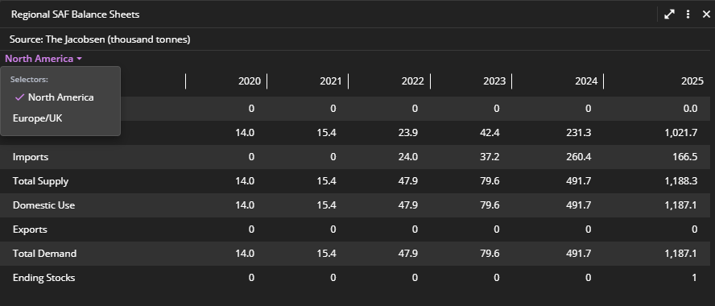
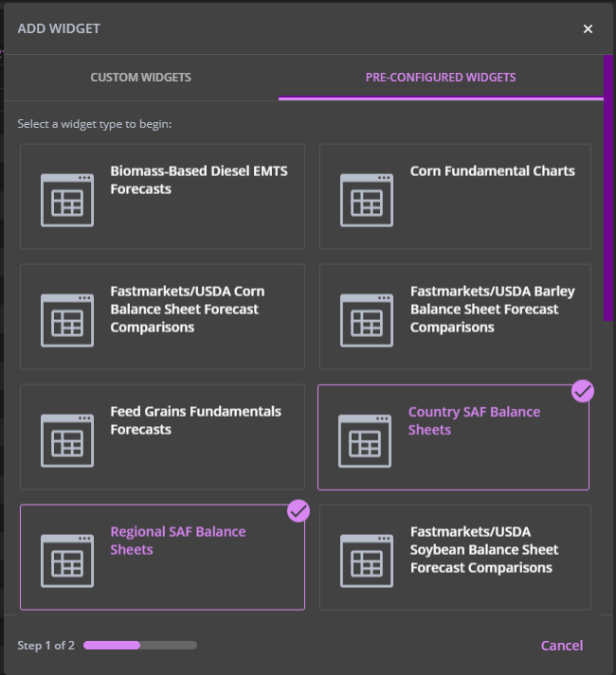
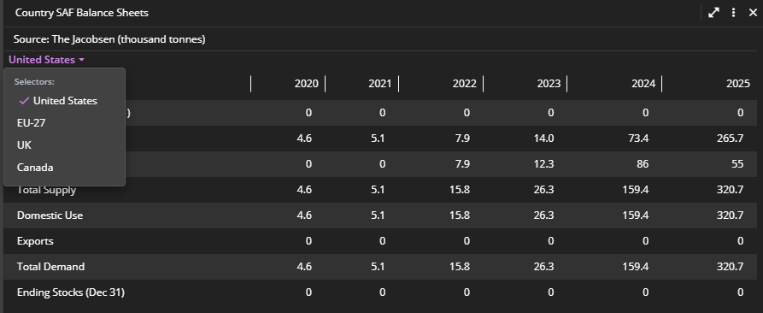
SAF Balance Sheets
New market data for OILS/FATS/BIOFUELS short-term forecast subscriber
Regional and country-level SAF (Sustainable Aviation Fuel) balance sheets tracking supply and demand data in the global market covering historical values and our 2024 & 2025 forecasts.
How to access
Pre-configured widgets>Regional SAF Balance Sheets
Pre-configured widgets>Country SAF Balance Sheets
3

Slide 4
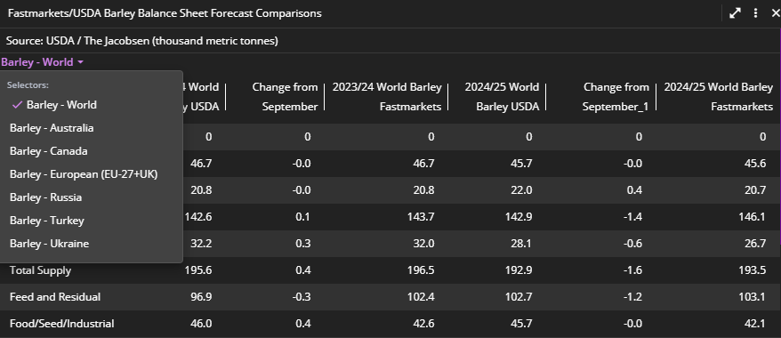
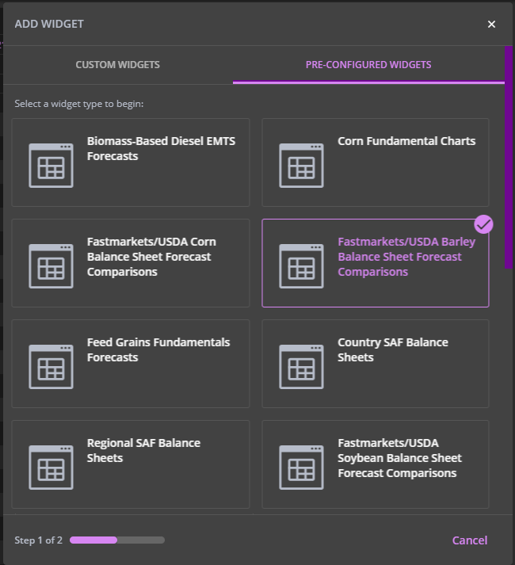
Fastmarkets/USDA Barley Balance Sheet Comparison
New market data for grain short-term forecast subscriber
Barley balance sheets incorporate data from both Fastmarkets and the USDA. These detailed sheets provide estimates of the volume of physical assets both globally and in six key markets for the two most recent market years.
How to access
Pre-configured widgets > Fastmarkets/USDA Barley Balance Sheet Forecast Comparisons
4

Slide 5
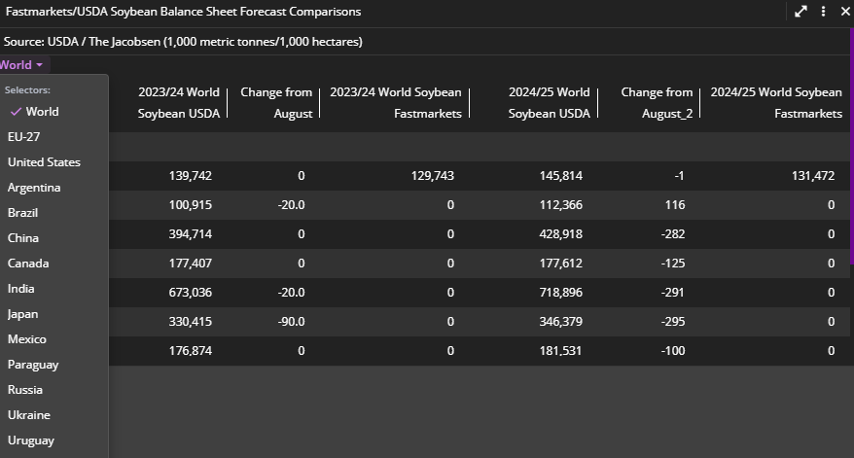
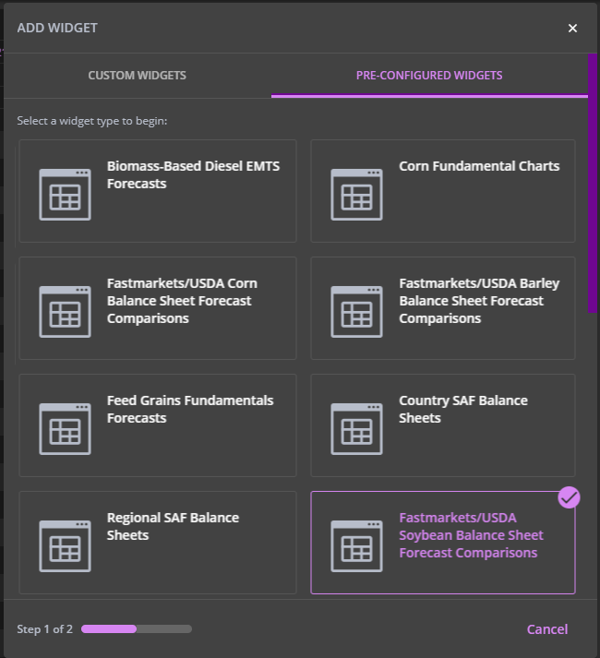
Fastmarkets/USDA Soybean Balance Sheet Comparison
New market data for grain short-term forecast subscriber
Soybean balance sheets feature data from both Fastmarkets and USDA. These comprehensive balance sheets cover fourteen key markets globally and provide estimates of the volume of physical assets in the agriculture sector over time.
How to access
Pre-configured widgets > Fastmarkets/USDA Soybean Balance Sheet Forecast Comparisons
5

Slide 6
FURTHER HELPtle Here
IF AFTER READING THESE INSTRUCTIONS YOU HAVE FURTHER QUESTIONS ABOUT HOW TO USE FASTMARKETS PLATFORM, CONTACT OUR CUSTOMER SUCCESS TEAMS OR FOR ACCESS/ORDER QUERIES, OUR CLIENT SERVICES TEAM:
Europe, Middle East and Africa: +44 20 3855 5581
Asia: +65 3163 3458
Americas: +1 708 329 2641
Customer Success Email: customersuccess@fastmarkets.com
Client Services Email: client.services@fastmarkets.com
For more information on Fastmarkets’ products and services, please use the following links:
Pricing data: https://www.fastmarkets.com/what-we-do/pricing-data
Pricing notices: https://www.fastmarkets.com/about-us/methodology/pricing-notices
Methodology: https://www.fastmarkets.com/about-us/methodology
Data Licensing: https://www.fastmarkets.com/solutions/data-licensing
00

